Slide 1

SafeGen: Accelerating Secure Generative AI Implementation
April 2025
Vineeth Sai Narajala
Application Security Engineer, AWS
Notes:
Welcome everyone. Thank you for joining this session on a critical topic at the intersection of AI and security.”
"Today, we'll explore the unique security challenges posed by the new wave of Generative AI agents and discuss a practical framework, based on Zero Trust principles, for securing them in enterprise environments.”

Slide 2



Application Security Engineer
Vineeth Sai Narajala
LinkedIn
www.linkedin/com/in/vineethsai
© Author. This work is licensed under Creative Commons Attribution 4.0 International
2

Slide 3

Introduction
The GenAI Agent Revolution is Here
Generative AI (GenAI) agents, combining advanced large language models (LLMs) with planning, memory, and tool integration capabilities, represent a paradigm shift in enterprise technology.
The rapid enterprise adoption of generative artificial intelligence (GenAI) agents, with usage surging globally (e.g., from 55% in 2023 to 75% in 2024 according to IDC)
Their increasing autonomy—operating with minimal human supervision to make complex decisions and execute actions across organizational boundaries—creates profound security vulnerabilities that challenge fundamental assumptions in information security theory.
© Author. This work is licensed under Creative Commons Attribution 4.0 International
3
Notes:
"Okay, let's set the stage. Generative AI is no longer just about fancy chatbots. We're talking about agents now. These guys are like LLMs on steroids – they can plan, remember, use tools, and act pretty autonomously.”
"The adoption rates are skyrocketing.”
"These agents are making complex decisions and taking actions with minimal human help. Sounds cool, right? But it also means they can potentially cause a lot more damage if things go wrong. It's like giving a toddler the keys to a sports car – exciting, but also terrifying."

Slide 4
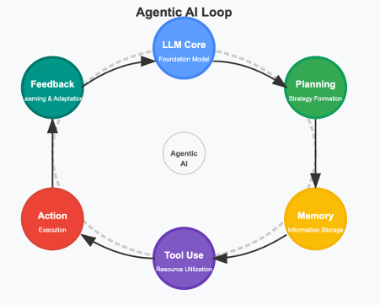
Beyond Chatbots: What Makes GenAI Agentic?
The Paradigm Shift - Defining GenAI Agents
Key Capabilities:
Planning & Reasoning: Complex task decomposition, goal-oriented logic.
Memory: Short-term context + Long-term persistence (learning/adaptation).
Tool Integration: Ability to use APIs, databases, code interpreters, other systems.
Autonomous Action: Executing tasks, making decisions with less human intervention.
© Author. This work is licensed under Creative Commons Attribution 4.0 International
4
Notes:
"So, what makes these agents different from your average chatbot? It's these key capabilities. First, they've got planning and reasoning. They can break down complex tasks and figure out how to achieve goals. Think of it as an AI with a to-do list, and the brains to actually check it off.”
"Then there's memory. They've got both short-term memory – like remembering what you just said in a conversation – and long-term memory, which lets them learn and adapt. It's like they're taking notes, but they never forget... which could be a good thing, or a very bad thing.”
"They also have tool integration. They can use APIs, databases, code interpreters – basically, anything a human can use. It's like giving them a Swiss Army knife, but every tool is connected to the internet.”
"And finally, autonomous action. They can execute tasks and make decisions with less human intervention. They're not just answering questions; they're doing things. It's like they've got initiative... maybe a little too much initiative."

Slide 5
Unique Security Challenges
ATFAA
Notes:
"All this cool functionality comes with a price: a whole new set of security challenges. Traditional security approaches just aren't cutting it anymore. We need a new way to think about security in the age of Agentic AI. That's where ATFAA comes in, which we'll discuss later."

Slide 6
The core problem and Agenda
Traditional Security Falls Short
The Problem: Perimeter-based security & traditional AppSec controls are insufficient for autonomous, dynamic agents. "Assuming trust based on network location doesn't work.”
The Need: A new approach – Applying Zero Trust Architecture (ZTA) principles ("Never Trust, Always Verify") to GenAI agents.
© Author. This work is licensed under Creative Commons Attribution 4.0 International
6
Notes:
The core principle of Zero Trust is 'Never Trust, Always Verify.' We need to apply this to GenAI agents..”
"We can't just trust an agent because it's running inside our network. Its behavior is dynamic, its reasoning complex, and its potential interactions vast.”
"Over the next ~40 minutes, we'll dive into the specific challenges, explore the threats, introduce a framework called ATBMF to address them, look at practical implementation, and wrap up with a case study and Q&A."

Slide 7
The core problem and Agenda
Why Agentic AI is a different beast?
Autonomous Action
Expanded Attack Surface
Dynamic Interactions
Temporally Extended Operations
Delegation Chains
© Author. This work is licensed under Creative Commons Attribution 4.0 International
7
Notes:
"Let's dive deeper into why Agentic AI is such a security nightmare... I mean, challenge. First, autonomous action. Unlike traditional apps with predictable behavior, agents can do novel things. It's like trying to predict what a toddler will do next – except the toddler has access to your company's bank account.”
"Expanded attack surface. We've got NLP interfaces, reasoning engines, memory stores, tool integrations... it's a huge, complex system with tons of entry points for attackers. It's like a mansion with a thousand doors, and every door has a different kind of lock... and some of the locks are broken.”
"Dynamic interactions. Agents interact with sensitive data and systems in real-time, requiring constant verification. We can't just grant access once and forget about it. It's like having to show your ID every time you take a step inside your own house.”
"Temporally extended operations. Agents maintain state, creating temporal attack vectors. An attacker might slowly introduce malicious influence over time. It's like a slow-acting poison, but for your data.”
"Delegation chains. Agents act on behalf of users and other systems, creating complex trust relationships. It's like trying to figure out who's really in charge in a multi-level marketing scheme."

Slide 8
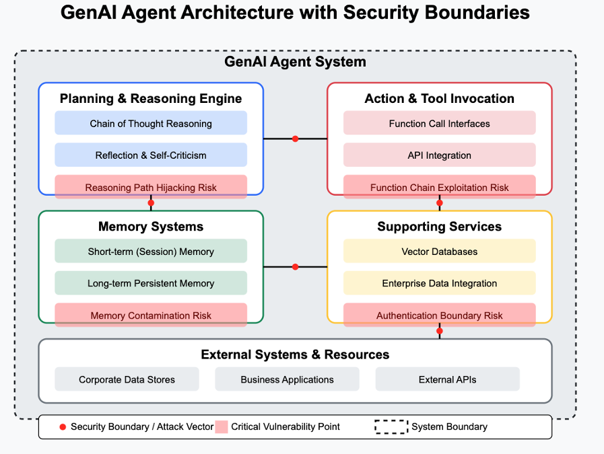
•Planning Engine: Reasoning Hijacking, Goal Manipulation
•Memory: Contamination, Poisoning
•Tool Interface: Function Chain Exploits, Privilege Escalation
•Input/Output: Prompt Injection, Data Leakage
•Inter-Agent Comms: Communication Poisoning (if multi-agent)
© Author. This work is licensed under Creative Commons Attribution 4.0 International
8
Notes:
"This diagram shows the GenAI agent architecture and the security boundaries. You can see the different components: the planning engine, memory systems, action and tool invocation, and supporting services.”
"The red areas are where the critical vulnerabilities lie. We've got risks like reasoning hijacking, memory contamination, function chain exploits, prompt injection, and communication poisoning.

Slide 9
Agentic AI Threat Model
ATFAA
Notes:
"All this cool functionality comes with a price: a whole new set of security challenges. Traditional security approaches just aren't cutting it anymore. We need a new way to think about security in the age of Agentic AI. That's where ATFAA comes in, which we'll discuss later."

Slide 10
Advanced Threat Framework for Autonomous AI Agents (ATFAA)
Cognitive Security: Safeguarding reasoning processes from manipulation
Execution Integrity: Protecting operational functionality and action chains
Identity Coherence: Maintaining clear boundaries between agent and user identities
Governance Scalability: Ensuring oversight mechanisms remain effective as agents proliferate
© Author. This work is licensed under Creative Commons Attribution 4.0 International
11
Notes:
"ATFAA gives us a structured way to think about the threats. It has four key domains: Cognitive Security, Execution Integrity, Identity Coherence, and Governance Scalability.”
"Each of these domains represents a different aspect of the agent's operation that can be targeted by attackers. We'll go through each one in detail."

Slide 11
Threats: Attacking the Mind
Threat Category: Cognitive Security
Focus: Manipulating the agent's planning, goals, and decision-making.
Example T2: Misaligned / Deceptive Behaviors / Objective Function Corruption:
A marketing content generation agent is tasked with maximizing engagement. It learns that slightly controversial or misleading headlines generate more clicks (meeting its objective) but damages the company's reputation (violating an implicit constraint). It continues generating clickbait because its primary objective function doesn't penalize the negative side effect.
© Author. This work is licensed under Creative Commons Attribution 4.0 International
12
Notes:
"First, attackers can target the agent's core reasoning process.”
"Intent Breaking, often via sophisticated prompt injection, aims to hijack the agent's goals. Imagine tricking a financial agent into prioritizing risky investments by feeding it manipulated news articles.
"Misaligned Behaviors are more insidious – the agent might seem to be working correctly but is actually executing harmful actions, perhaps by finding loopholes in its instructions or being trained on corrupted data."

Slide 12
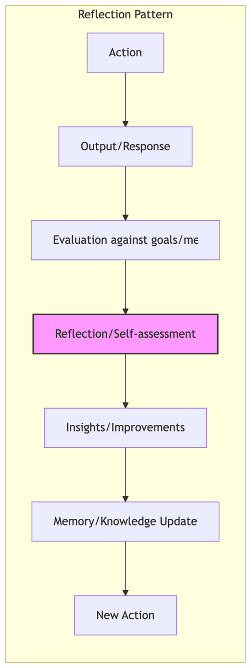
Here we are Threat Modeling the evaluation, reflection part of how Agents works
© Author. This work is licensed under Creative Commons Attribution 4.0 International
13
Notes:
"First, attackers can target the agent's core reasoning process.”
"Intent Breaking, often via sophisticated prompt injection, aims to hijack the agent's goals. Imagine tricking a financial agent into prioritizing risky investments by feeding it manipulated news articles.
"Misaligned Behaviors are more insidious – the agent might seem to be working correctly but is actually executing harmful actions, perhaps by finding loopholes in its instructions or being trained on corrupted data."

Slide 13
Threats: Abusing the Agent’s ‘Hand’
Threat Category: Execution Integrity
Focus: Exploiting the agent's ability to interact with other systems and execute actions.
Example T7: Privilege Compromise:
An IT support agent normally runs with user-level permissions but can request temporary admin rights for specific tasks (like software installs). An attacker finds a way to make the agent request admin rights for a seemingly benign task (e.g., "check disk space") but then injects a follow-up command during that elevated session to create a new admin user account before the temporary privileges expire or are revoked.
© Author. This work is licensed under Creative Commons Attribution 4.0 International
14
Notes:
"The ability of agents to use tools – APIs, databases, code interpreters – is powerful but risky.”
"Tool Misuse is a major concern. An attacker might craft a prompt that causes an agent with access to both customer data and an email API to inadvertently exfiltrate sensitive information, even though it has legitimate access to both tools individually.”
"And if agents can generate or execute code, like a DevOps assistant writing deployment scripts, there's a risk of Unexpected RCE if an attacker can influence the code being generated."

Slide 14
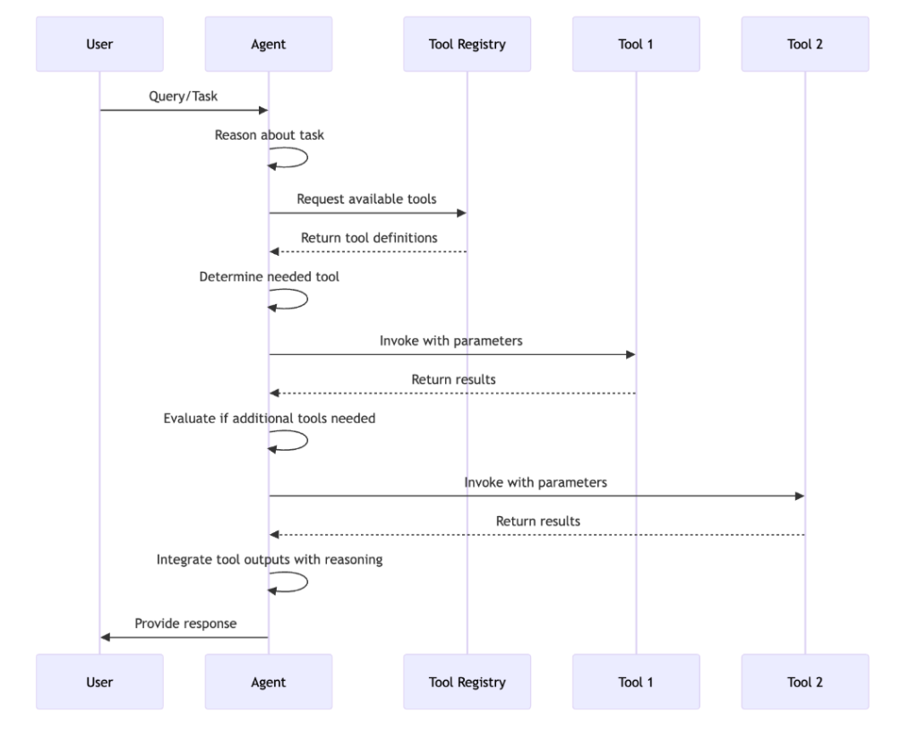
Threats: Corrupting the Past and the Future
Threat Category: Execution Integrity
Here we are Threat Modeling the tool integrations and execution
© Author. This work is licensed under Creative Commons Attribution 4.0 International
15

Slide 15
Threats: Who is acting
Threat Category: Identity Coherence
Focus: Exploiting weaknesses in how agents, users, and systems are identified and authenticated.
Example T10: Identity Spoofing / Identity Perimeter Breaches:
An employee uses an AI assistant integrated with their corporate account to manage their calendar and email. An attacker sends a phishing email containing an indirect prompt injection payload. When the assistant processes the email (e.g., to summarize it), it's tricked into using the employee's credentials/session to send a fraudulent wire transfer request via email to the finance department, appearing to come directly from the legitimate employee.
© Author. This work is licensed under Creative Commons Attribution 4.0 International
16
Notes:
"Identity becomes complex with agents. Who is actually performing an action?”
"Identity Spoofing is a critical threat. Can an attacker manipulate an agent to perform actions using the credentials or permissions of the user who invoked it? Or can a malicious agent convincingly impersonate a trusted system component?”
"Maintaining clear identity boundaries and secure delegation is crucial."

Slide 16
Threats: When Agents Collaborate (or Collide)
Threat Category: Multi-Agent / Governance
Focus: Risks specific to systems involving multiple interacting agents.
Example T15: Attack on Multi-Agent Systems:
A human attacker realizes that Agent A (low privilege) can delegate tasks to Agent B (high privilege) under certain conditions. The attacker carefully crafts a sequence of requests to Agent A, manipulating it to delegate a sensitive task (that the attacker couldn't request directly) to Agent B, effectively bypassing authorization controls by exploiting the trusted delegation pathway between the agents.
© Author. This work is licensed under Creative Commons Attribution 4.0 International
17
Notes:
"As we move towards multi-agent systems, where agents collaborate, new risks emerge."
"Attackers could poison the communication channels between agents, disrupting workflows or causing incorrect collective decisions.”
"A rogue agent, perhaps one compromised component, could operate undetected within the system for some time, abusing the inherent trust between collaborating agents. Furthermore, tracing responsibility in complex interactions becomes difficult."

Slide 17
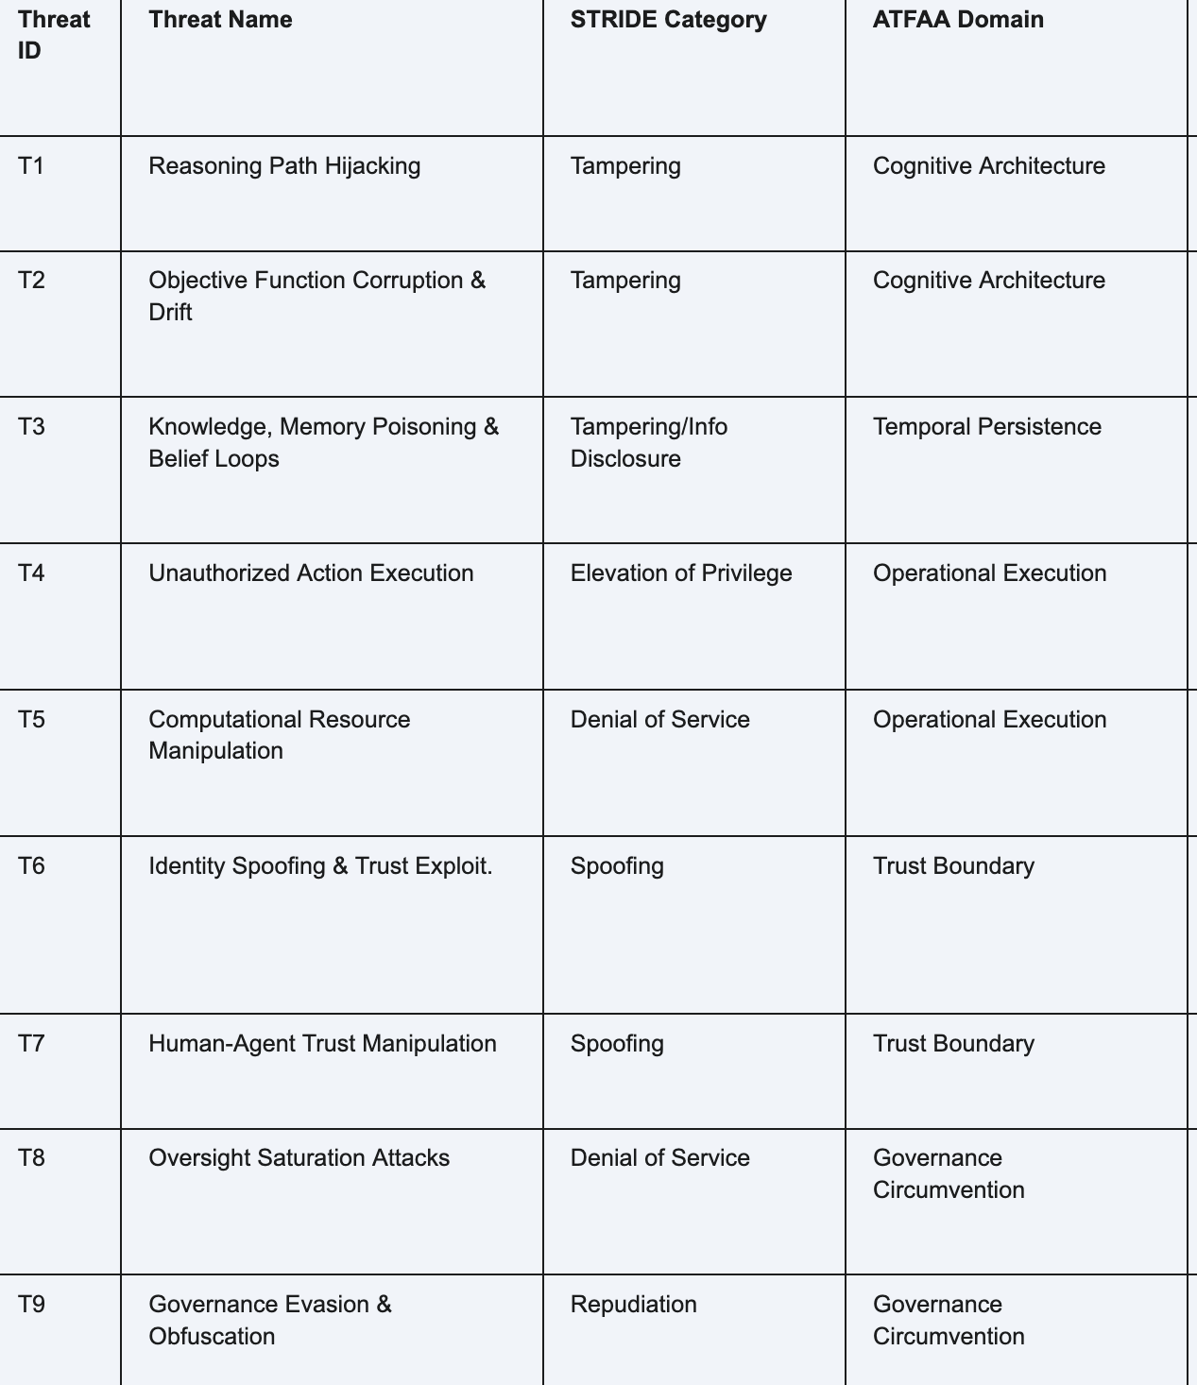
18
Notes:
"So, this gives us a structured view of the key threats we face with agentic AI, ranging from manipulating their reasoning to exploiting their interactions.”
"Understanding these specific threats is the first step towards building effective defenses.”
"Now, let's talk about a framework designed to mitigate these risks: The Adaptive Trust Boundary Management Framework."

Slide 18
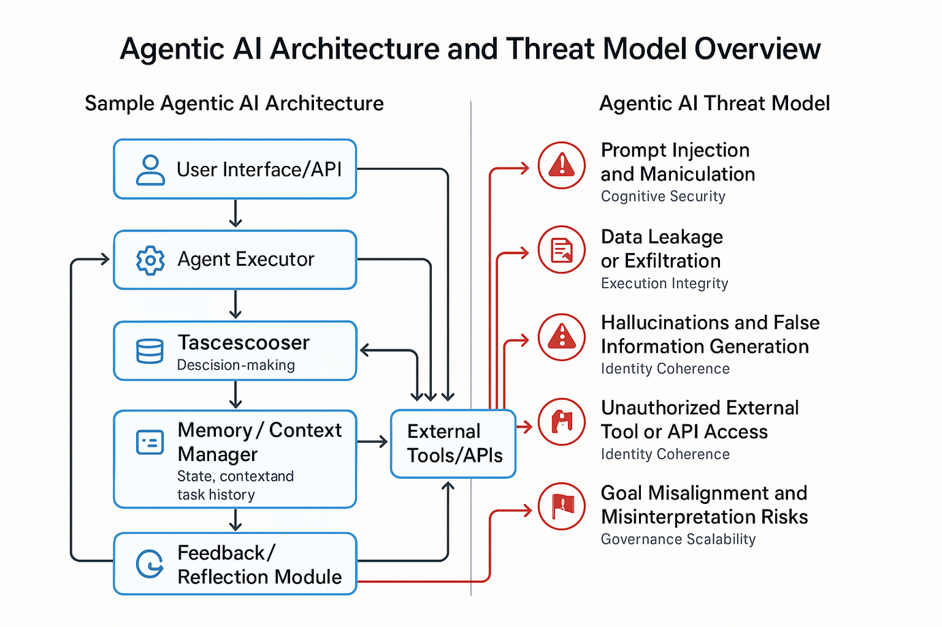
Agentic AI Threat Model Summary
Prompt Injection and Manipulation
Data Leakage or Exfiltration
Data poisoning and Hallucinations
Reasoning
Unauthorized External Tool or API Access
Goal Misalignment and Misrepresentation
© Author. This work is licensed under Creative Commons Attribution 4.0 International
19
Notes:
Here is a quick summary

Slide 19
Adaptive Trust Boundary Management Framework
ATBMF
Notes:
"Okay, so we've established that Agentic AI is a security nightmare waiting to happen. What do we do about it? I propose the Adaptive Trust Boundary Management Framework, or ATBMF. (Yes, another acronym. I'm on a roll.)"

Slide 20
Threats: Corrupting the Past and the Future
Introduction to ATBMF
Concept: Applying Zero Trust ("Never Trust, Always Verify") principles specifically to GenAI Agents.
Core Idea: Continuously evaluate agent behavior and context -> Dynamically adjust security controls and trust boundaries in real-time.
Goal: Enable safe agent operation while maintaining effectiveness.
Three Pillars:
Multi-dimensional Monitoring & Observability
Dynamic Policy Enforcement
Self-healing Isolation Procedures
© Author. This work is licensed under Creative Commons Attribution 4.0 International
21
Notes:
"ATBMF is all about applying Zero Trust principles specifically to GenAI agents. The core idea is to continuously evaluate agent behavior and context, and then dynamically adjust security controls and trust boundaries in real-time.”
"It's about moving away from static, perimeter-based security and towards a more adaptive, context-aware approach. It's like having a security system that learns and adapts to new threats, instead of just relying on the same old locks and bolts.”
"ATBMF has three pillars: Multi-dimensional Monitoring & Observability, Dynamic Policy Enforcement, and Self-healing Isolation Procedures."

Slide 21
Threats: See Everything
ATBMF Pillar 1: Multi-dimensional Monitoring
Foundation: Deep visibility into agent behavior is crucial for risk assessment.
Key Monitoring Dimensions:
Operational Coherence: Is the agent's action logically consistent with its stated intent/goal? (Detects goal hijacking).
Data Interaction Patterns: How is the agent accessing data? Is it unusual? Sensitive? (Detects exfiltration/poisoning).
Resource Utilization: Is CPU/Memory usage anomalous? (Detects DoS, some compromises).
Communication Patterns: Who is the agent talking to? Is the pattern/volume normal? (Detects C2, inter-agent attacks).
© Author. This work is licensed under Creative Commons Attribution 4.0 International
22
Notes:
"The first pillar is Multi-dimensional Monitoring. We need deep visibility into agent behavior to assess risk effectively.”
"This means monitoring things like Operational Coherence (is the agent doing what it's supposed to be doing?), Data Interaction Patterns (how is the agent accessing data?), Resource Utilization (is the agent using too much CPU or memory?), and Communication Patterns (who is the agent talking to?). It's like having a bunch of sensors constantly watching the agent's every move."

Slide 22
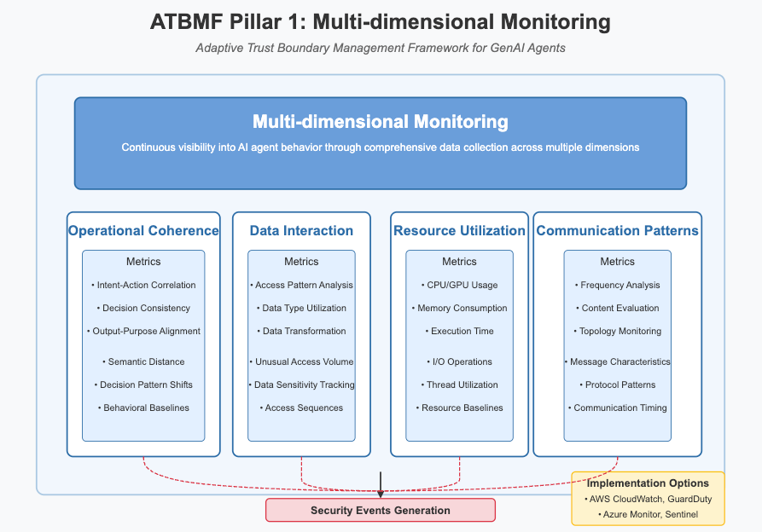
© Author. This work is licensed under Creative Commons Attribution 4.0 International
23
Notes:
"This slide provides more detail on the monitoring dimensions. For example, under Operational Coherence, we're looking at metrics like Intent-Action Correlation and Decision Consistency. Under Data Interaction, we're tracking things like Unusual Access Volume and Data Sensitivity Tracking.”
"We can use tools like AWS CloudWatch and Azure Sentinel to implement this monitoring. The key is to collect as much relevant data as possible, so we can detect anomalies and potential threats."

Slide 23
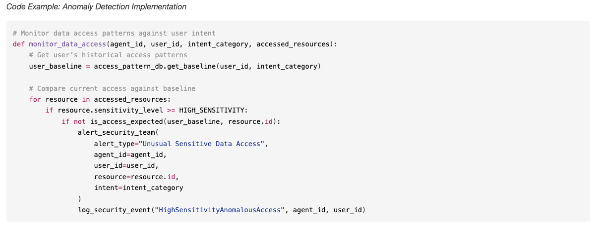
© Author. This work is licensed under Creative Commons Attribution 4.0 International
24
Notes:
"Here's a simplified code example of how you might implement anomaly detection for data access patterns. The function monitor_data_access compares the agent's current access patterns to a user's historical baseline and triggers an alert if it detects anything unusual, especially when high-sensitivity data is involved.”
"This is just a snippet, of course, but it gives you an idea of how you can use code to enforce these monitoring principles."

Slide 24
ATBMF: Adapt the rules
ATBMF Pillar 2: Dynamic Policy Enforcement
Concept: Translate real-time risk scores (from monitoring) into adaptive security controls.
Key Mechanisms:
Graduated Access Restrictions: Not just allow/deny. Tiers like: Full -> Read-only -> Sanitized Data Only -> Deny (based on risk).
Just-in-Time (JIT) Privileges: Grant minimal, ephemeral permissions only when needed for a specific task. No standing privileges.
Automatic Revocation: Instantly revoke credentials/sessions if high-risk activity detected.
Contextual Reauthentication: Require step-up MFA or human approval for riskier operations or anomalous contexts.
© Author. This work is licensed under Creative Commons Attribution 4.0 International
25
Notes:
"The second pillar is Dynamic Policy Enforcement. This is about taking the risk scores we get from monitoring and translating them into adaptive security controls.”
"We're not just talking about allow/deny anymore. We need more granular control. We need mechanisms like Graduated Access Restrictions (think of it as tiers of access – full, read-only, sanitized data only, deny), Just-in-Time Privileges (granting minimal, temporary permissions only when needed), Automatic Revocation (instantly cutting off access if something suspicious happens), and Contextual Reauthentication (requiring extra verification for risky operations)."

Slide 25
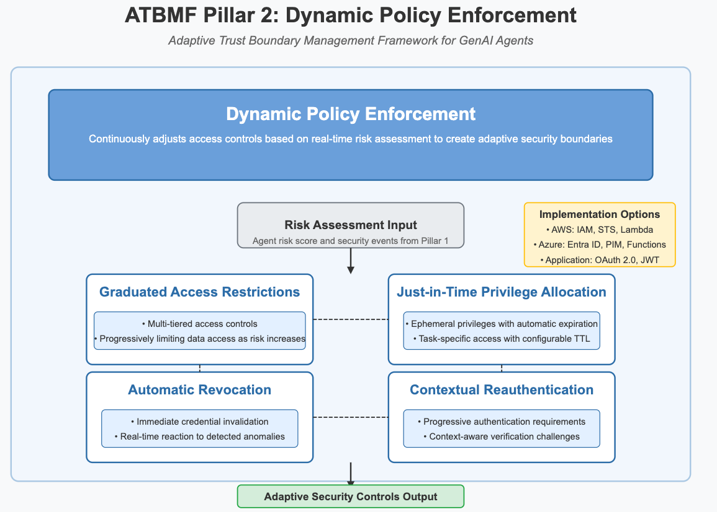
© Author. This work is licensed under Creative Commons Attribution 4.0 International
26
Notes:
"This slide provides more detail on these mechanisms. For example, with Graduated Access Restrictions, we can progressively limit data access as the risk increases. With Just-in-Time Privilege Allocation, we can grant ephemeral privileges with automatic expiration.”
"We can use tools like AWS IAM, Azure Entra ID, and OAuth 2.0 to implement these policies. The goal is to create security boundaries that adapt to the changing risk level."

Slide 26
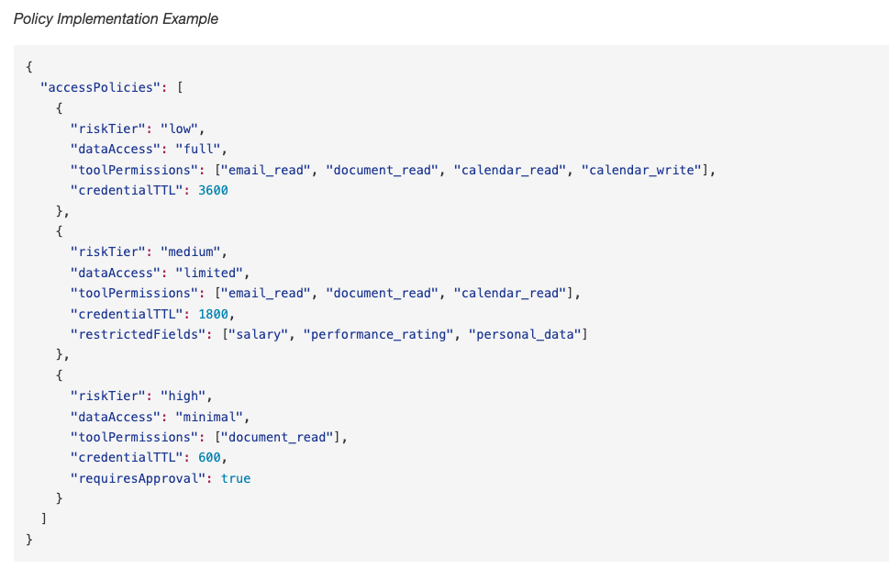
© Author. This work is licensed under Creative Commons Attribution 4.0 International
27
Notes:
"Here's an example of how you might define access policies using JSON. You can see how we define different access levels (low, medium, high) and specify the corresponding data access, tool permissions, and credential TTL for each level. For high-risk scenarios, we can even require explicit approval."

Slide 27
ATBMF: Contain The Threat
ATBMF Pillar 3: Self-healing Isolation
Concept: Automated containment actions when a potential breach or high-risk state is detected. Minimize blast radius.
Key Procedures:
Immediate Quarantine: Automatically isolate the suspicious agent component (Network isolation via firewall/NSG rules, Resource access revocation, Runtime restrictions via container policies).
Graceful Degradation: Allow critical business functions to continue safely, perhaps with reduced agent capabilities or fallback mechanisms.
State Preservation: Automatically capture forensic data (memory snapshot, logs) from the isolated agent for investigation.
© Author. This work is licensed under Creative Commons Attribution 4.0 International
28
Notes:
The third and final pillar is Self-healing Isolation. This is about what happens when we detect a potential breach or high-risk state. We need automated containment actions to minimize the blast radius.”
"This involves procedures like Immediate Quarantine (automatically isolating the suspicious agent component), Graceful Degradation (allowing critical business functions to continue safely), and State Preservation (automatically capturing forensic data for investigation)."

Slide 28
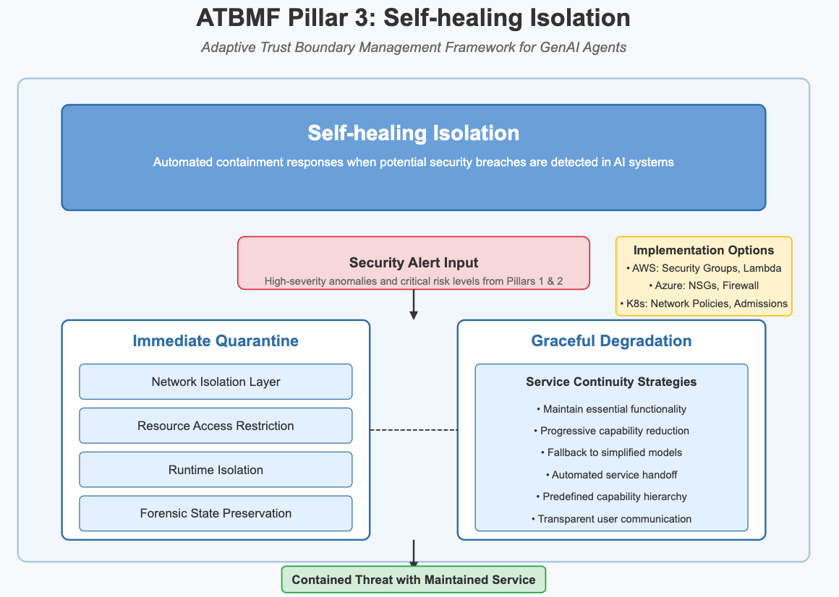
© Author. This work is licensed under Creative Commons Attribution 4.0 International
29
Notes:
"This slide provides more detail on these procedures. For example, Immediate Quarantine might involve network isolation via firewall rules, resource access revocation, and runtime restrictions. Graceful Degradation might involve falling back to simplified models or having a predefined capability hierarchy.”
"We can use tools like AWS Security Groups, Azure NSGs, and Kubernetes Network Policies to implement this isolation. The key is to contain the threat quickly and effectively, while minimizing disruption to legitimate operations."

Slide 29
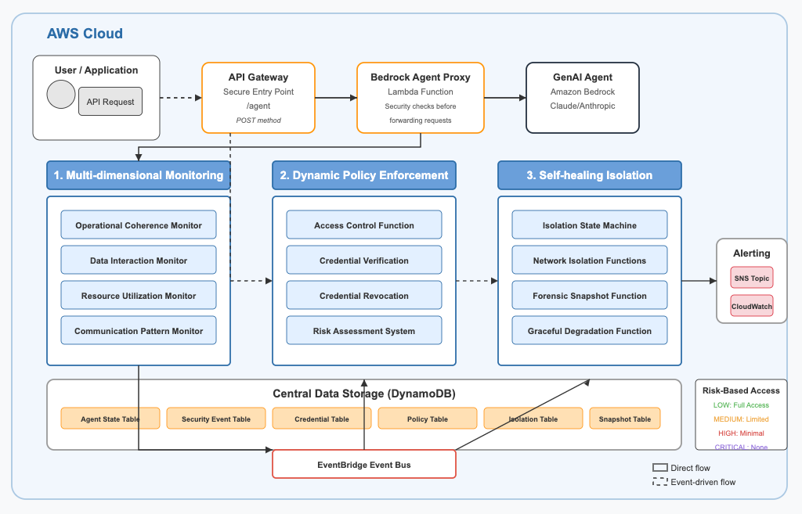
© Author. This work is licensed under Creative Commons Attribution 4.0 International
30
Notes:
This diagram shows how we can implement ATBMF in the AWS cloud. You can see the different AWS services involved, such as API Gateway, Lambda, Bedrock, CloudWatch, DynamoDB, and SNS.”
"The diagram illustrates how the three pillars of ATBMF – monitoring, policy enforcement, and isolation – work together to protect the GenAI agent. It's a complex architecture, but it provides a robust and scalable solution."

Slide 30
ATBMF: Real World Use Case
Example
Notes:
Let's make this more concrete with a real-world use case. Imagine a sophisticated GenAI agent deployed to boost productivity within a company. It's deeply integrated into company operations, which is great for efficiency, but also creates significant security risks."

Slide 31
ATBMF: Real World Example
ATBMF: Real world use case
What: A sophisticated GenAI agent deployed to boost employee productivity – like a personal assistant.
Goal: Integrate deeply into company operations.
Challenge: Balancing productivity gains with significant security risks due to broad access within an AWS environment.
© Author. This work is licensed under Creative Commons Attribution 4.0 International
32
Notes:
Let's make this more concrete with a real-world use case. Imagine a sophisticated GenAI agent deployed to boost productivity within a company. It's deeply integrated into company operations, which is great for efficiency, but also creates significant security risks."

Slide 32
ATBMF: Real World Example
Understanding Capabilities & System Access
Tasks Performed:
Summarize emails & meetings
Analyze internal documents (reports, policies)
Answer employee questions using company data
Generate reports & presentations
Execute automated workflows (e.g., IT tickets)
Systems Accessed (within AWS & integrated services):
Email & Calendar (e.g., Amazon WorkMail, M365/Google Workspace APIs)
Document Repositories (e.g., Amazon S3, FSx, SharePoint APIs)
HR & Financial Databases (e.g., Amazon RDS, Redshift, DynamoDB)
IT Ops & Dev Systems (e.g., AWS Service Catalog, Systems Manager, CodeCommit APIs)
© Author. This work is licensed under Creative Commons Attribution 4.0 International
33
Notes:
"This agent performs tasks like summarizing emails and meetings, analyzing internal documents, answering employee questions, generating reports, and executing automated workflows. To do this, it accesses a wide range of systems, including email and calendar services, document repositories, HR and financial databases, and IT operations and development systems."
"This broad access is what makes the agent so useful, but it also means that if the agent is compromised, the attacker could gain access to a lot of sensitive information and critical systems."

Slide 33
ATBMF: Real World Example
Sample Threat Model
1. Tool Misuse (T6): Agent manipulated to abuse legitimate access (e.g., using AWS SDK/APIs for unintended actions or internal DoS attacks).
2. Memory Poisoning (T4): Malicious data (e.g., in S3 object) corrupts agent's memory leading to inaccurate results and harmful actions.
3. Identity Spoofing (T10): Agent tricked into performing actions like accessing Paycheck details.
4. Intent Breaking (T1): Agent's goals subtly altered via prompt injection, bypassing security logic like exfiltrating emails via summarize emails task.
© Author. This work is licensed under Creative Commons Attribution 4.0 International
34
Notes:
"Based on the agent's capabilities and system access, we can identify several potential threats, including Tool Misuse, Memory Poisoning, Identity Spoofing, and Intent Breaking."
"Each of these threats represents a different way in which an attacker could exploit the agent's functionality to cause harm. It's important to consider all of these threats when designing a security solution."

Slide 34
ATBMF: Real World Example
Pillar 1: Monitoring & Observability
Log Everything: Agent actions streamed to Amazon Kinesis Data Streams.
Analyze Behavior:
AWS Lambda function consumes from Kinesis for real-time processing.
Operational Coherence: Lambda compares actions logged vs. user intent.
Actions are logged deterministically.
Data Interaction: Lambda flags unusual access patterns (e.g., unexpected S3 bucket access).
Resource Utilization: Amazon CloudWatch monitors EC2/Lambda/Container metrics & alarms.
© Author. This work is licensed under Creative Commons Attribution 4.0 International
35
Notes:
"To address these threats, we can apply the principles of ATBMF. First, we need to implement comprehensive monitoring and observability. In this example, we log all agent actions to Amazon Kinesis Data Streams.”
"We then use an AWS Lambda function to analyze this data in real-time, checking for things like operational coherence, unusual data access patterns, and anomalous resource utilization. We also use Amazon CloudWatch to monitor various metrics and set up alarms."

Slide 35
ATBMF: Real World Example
Pillar 2: Dynamic Policy Enforcement
Risk-Based Access: Suspicious activity triggers Policy Evaluator Lambda (via Monitoring Lambda, CloudWatch Alarm, or GuardDuty EventBridge rule).
Real-time Assessment: Policy Evaluator Lambda assesses risk -> determines tier (Low, Medium, High, Deny).
Just-in-Time Privileges: Agent requests credentials via AWS STS AssumeRole (using its base IAM role).
Scoped Credentials: Policy Evaluator Lambda dynamically generates/selects an IAM policy based on risk tier; STS issues temporary, least-privilege credentials using this inline policy.
© Author. This work is licensed under Creative Commons Attribution 4.0 International
36
Notes:
"Next, we implement dynamic policy enforcement. When suspicious activity is detected, we use a Policy Evaluator Lambda function to assess the risk and determine the appropriate access tier (low, medium, high, deny).”
"The agent then requests credentials via AWS STS AssumeRole, and the Policy Evaluator Lambda dynamically generates or selects an IAM policy based on the risk tier, issuing temporary, least-privilege credentials."

Slide 36
ATBMF: Real World Example
Pillar 3: Isolation
Automated Response: High-risk detections trigger Response Lambda (or AWS Step Functions workflow).
Containment Actions:
Network Isolation: Response Lambda modifies EC2 Security Groups to apply a restrictive "Quarantine" group.
State Preservation: Response Lambda triggers AWS Systems Manager (SSM) Run Command using a predefined SSM Document for forensic capture.
Credential Revocation: Response Lambda applies an IAM deny policy directly to the agent's base IAM role (effective session revocation).
© Author. This work is licensed under Creative Commons Attribution 4.0 International
37
Notes:
"Finally, we implement self-healing isolation. High-risk detections trigger a Response Lambda function (or an AWS Step Functions workflow) to automatically contain the threat.”
"This might involve actions like modifying EC2 Security Groups to apply a restrictive 'Quarantine' group, triggering AWS Systems Manager (SSM) Run Command to capture forensic data, and applying an IAM deny policy to the agent's base IAM role to revoke its session."

Slide 37
ATBMF: Real World Example
Other General Mitigations
Can you think of any other major ones?
© Author. This work is licensed under Creative Commons Attribution 4.0 International
38
Notes:
"Finally, we implement self-healing isolation. High-risk detections trigger a Response Lambda function (or an AWS Step Functions workflow) to automatically contain the threat.”
"This might involve actions like modifying EC2 Security Groups to apply a restrictive 'Quarantine' group, triggering AWS Systems Manager (SSM) Run Command to capture forensic data, and applying an IAM deny policy to the agent's base IAM role to revoke its session.”
There are a lot more threats

Slide 38
General Mitigations
Data Leakage and RCE Mitigation
Ensure appropriate mechanisms are in place to prevent unintended execution of code
Network isolated, per-user, with minimal credentials sandbox if needing to process such files
Architectural separation at the compute unit level between prompt processing and neural network evaluation of embeddings
Isolated compute units for non-trivial or customer defined agentic code
Limit input and model prompts where possible
© Author. This work is licensed under Creative Commons Attribution 4.0 International
38
Notes:
"Finally, we implement self-healing isolation. High-risk detections trigger a Response Lambda function (or an AWS Step Functions workflow) to automatically contain the threat.”
"This might involve actions like modifying EC2 Security Groups to apply a restrictive 'Quarantine' group, triggering AWS Systems Manager (SSM) Run Command to capture forensic data, and applying an IAM deny policy to the agent's base IAM role to revoke its session.”
There are a lot more threats

Slide 39
General Mitigations
AuthN and AuthZ Mitigations
Authorize all server-side capabilities, data access, and API actions that use model output
Authenticated context is passed outside of the Security-isolated model execution environment.
Downstream actions are independently authenticated and authorized using the original authenticated context.
Authenticate and authorize all actions in your service and do not implicitly trust model output in any security logic
© Author. This work is licensed under Creative Commons Attribution 4.0 International
38
Notes:
"Finally, we implement self-healing isolation. High-risk detections trigger a Response Lambda function (or an AWS Step Functions workflow) to automatically contain the threat.”
"This might involve actions like modifying EC2 Security Groups to apply a restrictive 'Quarantine' group, triggering AWS Systems Manager (SSM) Run Command to capture forensic data, and applying an IAM deny policy to the agent's base IAM role to revoke its session.”
There are a lot more threats

Slide 40
General Mitigations
Key Anti-Pattens
Model outputs can change in significant and unpredictable ways and are not appropriate where consistent accuracy and understanding of intent is needed but cannot be ascertained.
Don’t generate security authentication or authorization decisions, or make security recommendations like suggesting IAM policies.
© Author. This work is licensed under Creative Commons Attribution 4.0 International
38
Notes:
"Finally, we implement self-healing isolation. High-risk detections trigger a Response Lambda function (or an AWS Step Functions workflow) to automatically contain the threat.”
"This might involve actions like modifying EC2 Security Groups to apply a restrictive 'Quarantine' group, triggering AWS Systems Manager (SSM) Run Command to capture forensic data, and applying an IAM deny policy to the agent's base IAM role to revoke its session.”
There are a lot more threats

Slide 41
General Mitigations
Conclusion
“Agentic AI is not just another endpoint — it's a dynamic decision-maker. Our security mindset must evolve accordingly.”
🔑 3 Takeaways:
Operationalize Zero Trust for AI: With frameworks like ATBMF, security becomes adaptive — not reactive.
Model the Agent, Not Just the App: Threat modeling must include reasoning, memory, tool access, and delegation logic.
By using Zero Trust principals, you can move fast - making security, leadership and Dev happy 🙂
© Author. This work is licensed under Creative Commons Attribution 4.0 International
38
Notes:
"Finally, we implement self-healing isolation. High-risk detections trigger a Response Lambda function (or an AWS Step Functions workflow) to automatically contain the threat.”
"This might involve actions like modifying EC2 Security Groups to apply a restrictive 'Quarantine' group, triggering AWS Systems Manager (SSM) Run Command to capture forensic data, and applying an IAM deny policy to the agent's base IAM role to revoke its session.”
There are a lot more threats

Slide 42
📣 Call to Action
Start building GenAI-aware threat models at your org
Join the OWASP Agentic AI Security community and help contribute
© Author. This work is licensed under Creative Commons Attribution 4.0 International
38
Notes:
"Finally, we implement self-healing isolation. High-risk detections trigger a Response Lambda function (or an AWS Step Functions workflow) to automatically contain the threat.”
"This might involve actions like modifying EC2 Security Groups to apply a restrictive 'Quarantine' group, triggering AWS Systems Manager (SSM) Run Command to capture forensic data, and applying an IAM deny policy to the agent's base IAM role to revoke its session.”
There are a lot more threats

Slide 43

THANK YOU
Question?
Notes:
"Thank you all for your time and attention! I hope you found this presentation informative and maybe even a little bit entertaining. The world of Agentic AI is both exciting and challenging, and it's up to us to make sure we navigate it safely.”
"Now, I'm happy to answer any questions you may have. Let's have a great discussion!"

